Slide 1
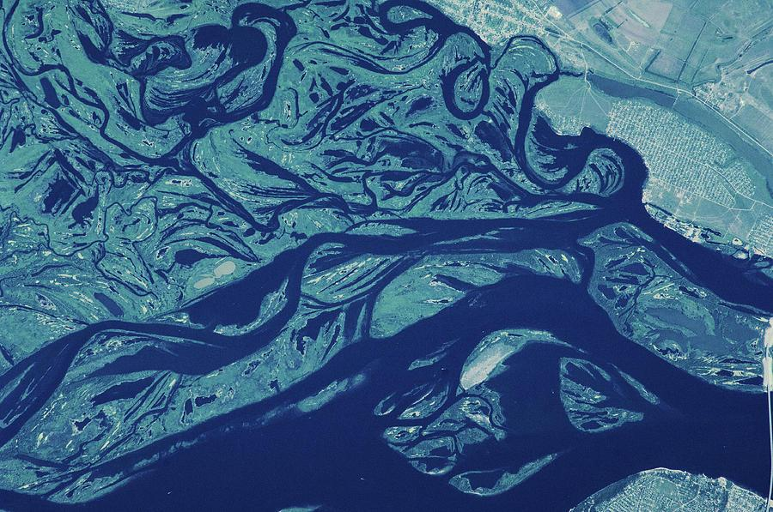
How Much Water Makes A Flood?
Exploring the Relationship Between River Gage Data and Flood Extent
A RIMORPHIS Initiative
Avra Saslow and Kristen Tortorelli
Notes:
Hey there everyone, we wanted to do a status update for the RIMORPHIS project that Kristen and I have been thus far for the summer.

Slide 2
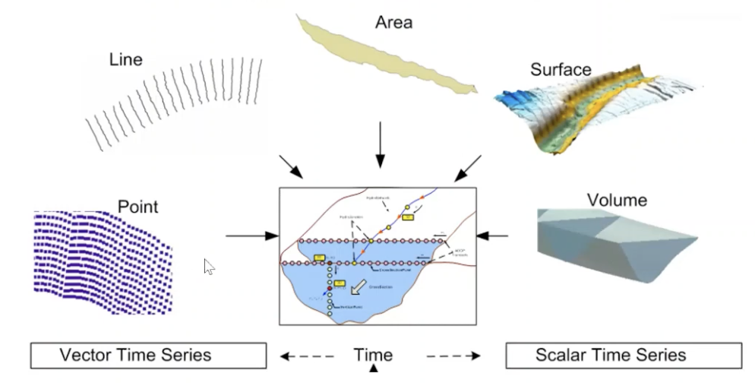
Project Goal: Understand How Water Floods
Develop a tool that extracts river geometry
Flood modelling and mapping
Understand temporal and spatial trends in river morphology from a synchronous standpoint rather than historical standpoint
Track bank and channel migrations
Courtesy of RIMORPHIS
Notes:
The overarching premise of our project is to understand how water floods.
To start, I want to emphasize that we’re positioned within the RIMORPHIS, or the River Morphology Information System, which is a NSF funded, cross-institutional project that aims to provide a application to aid in river morphology research - so tracking and monitoring streamflow and sediment transport in stream bed across the US.
So RIMORPHIS is really trying to extract insights about river morphology using a variety of parameters, like the diagram here shows. River morphology and floods are multi-dimensional, so to properly understand them we need inputs from the surface topography, water volume, water area, and point and line topologies.
Mine and Kristen’s role in this larger project looks specifically at the intersection of water volume and water area to better understand flooding. We’re helping to develop a tool that will extract river geometry during flood events and compare water area to water volume.
This kind of tool can help aid in flood modelling and mapping - so we can better understand flood events based on current observations, not just historical observations?
It can also help us better understand bank and channel migrations, like how river banks change over time, or which channels in the US are moving consistently with time.
Flood modelling and mapping - where is top of bank?
Temporal and spatial trends in river morphology - it’s pretty hard to say which channels in the US are moving consistently with time
Here’s where it’s moving year to year.
NDWI gives us where the edge of water is - processed imagery
High sediment loads
Before, during and after event
Bank migrations
what ‘s the possible reach, how the bank changes over time.

Slide 3
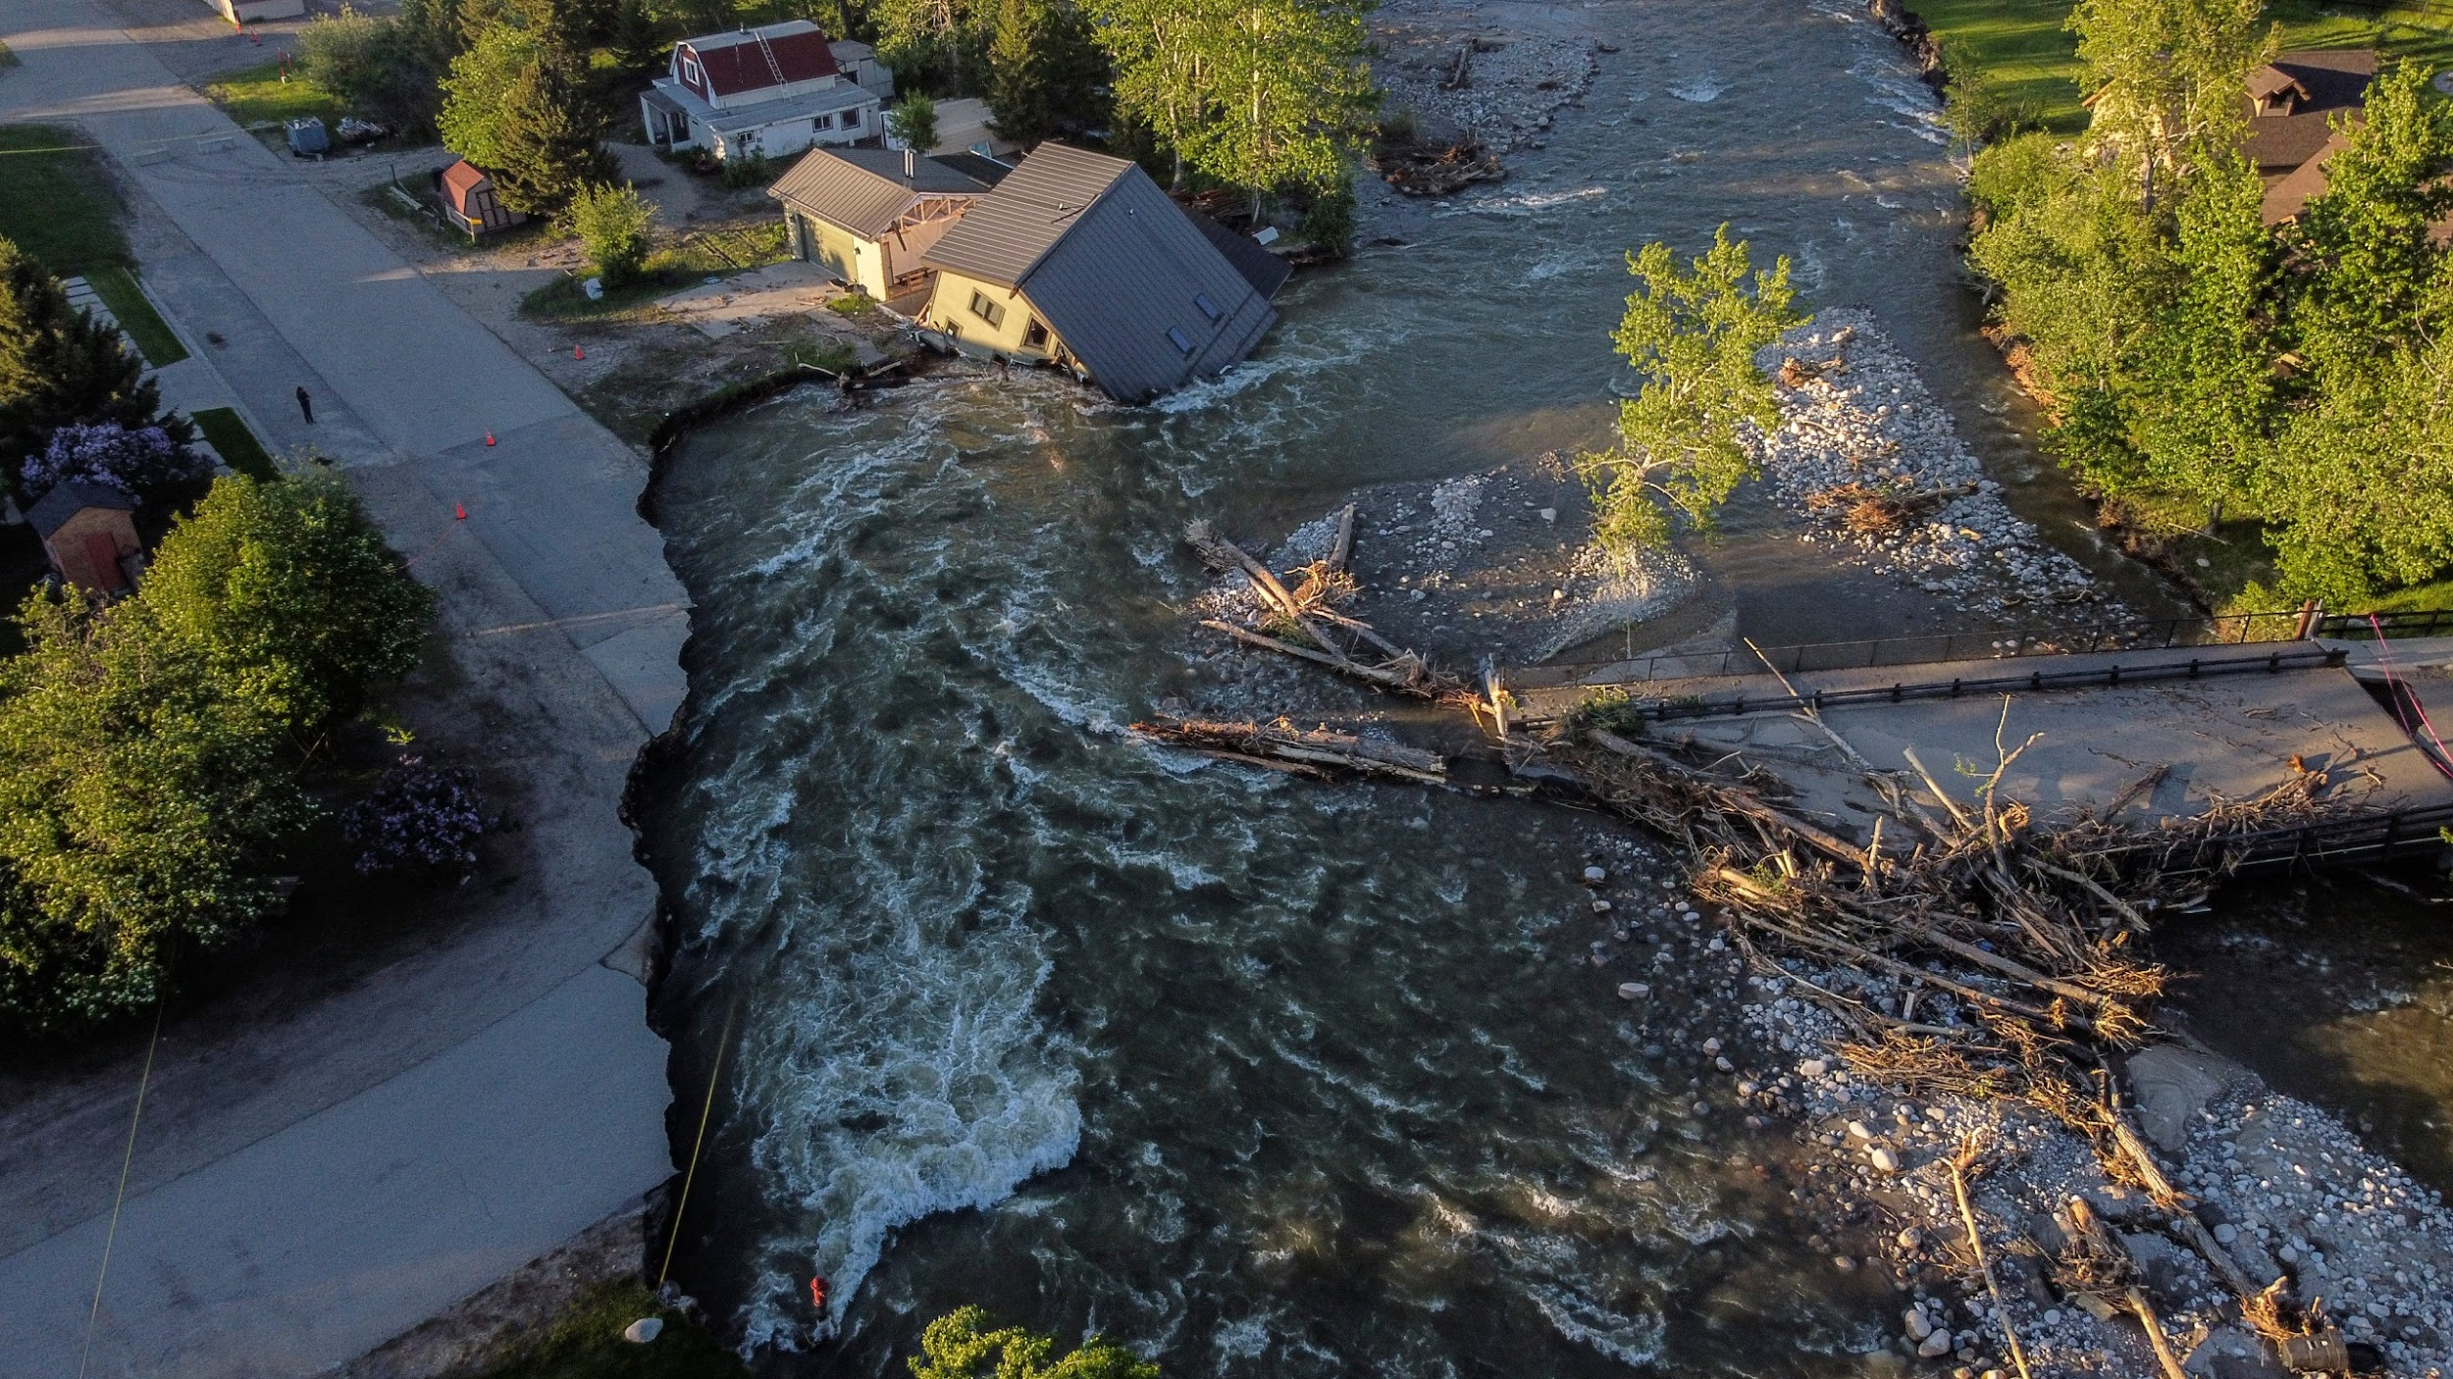
Importance of Flood Modelling
Infrastructure, such as building bridges to withstand ~hundred year floods
Mitigate effect of flood hazards in areas with agriculture and critical habitats
Track sediment transport through water conduits
June 2022 - Red Lodge, Montana
Notes:
So why does it matter to know these things, like how channels move over time, or not only how much is flooding, but where that water is going?
Well, there was a pretty recent example that I think contextualizes this problem well. Earlier this month, Montana and Idaho and Washington all had extraordinary floods due to a very wet spring. In particular, Red Lodge Montana experienced a 500-year flood that ripped out houses and vehicle bridges. Modelling flooding and understanding where the water goes can help us make informed decisions about how we build our infrastructure. Should we go through the extra time and money to build bridges that can withstand the next 500-year flood? Or should we rebuild a bridge within the new geometry of the channel that we can accept will be broken again in the next historic flood?
Furthermore, knowing where water goes in relation to how much water is flooding can help us mitigate critical habitats and agriculture land.
And lastly, since riverbeds are essentially conduits for sediment, we can try learn about how sediment is transported through watersheds before, during and after flood events.

Slide 4
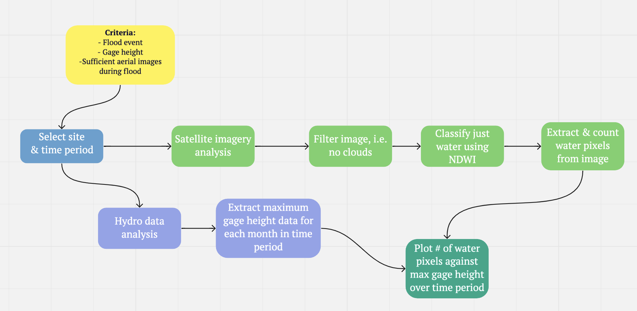
Methods: Plot Water Area vs. Water Volume
Notes:
Plotting water area against water volume
Why we used discharge on one, and gage height on the other: definite sites that have one or the other
If you have only gage height, you might need some intermediary calculations to understand
You need the river channel and geometry

Slide 5
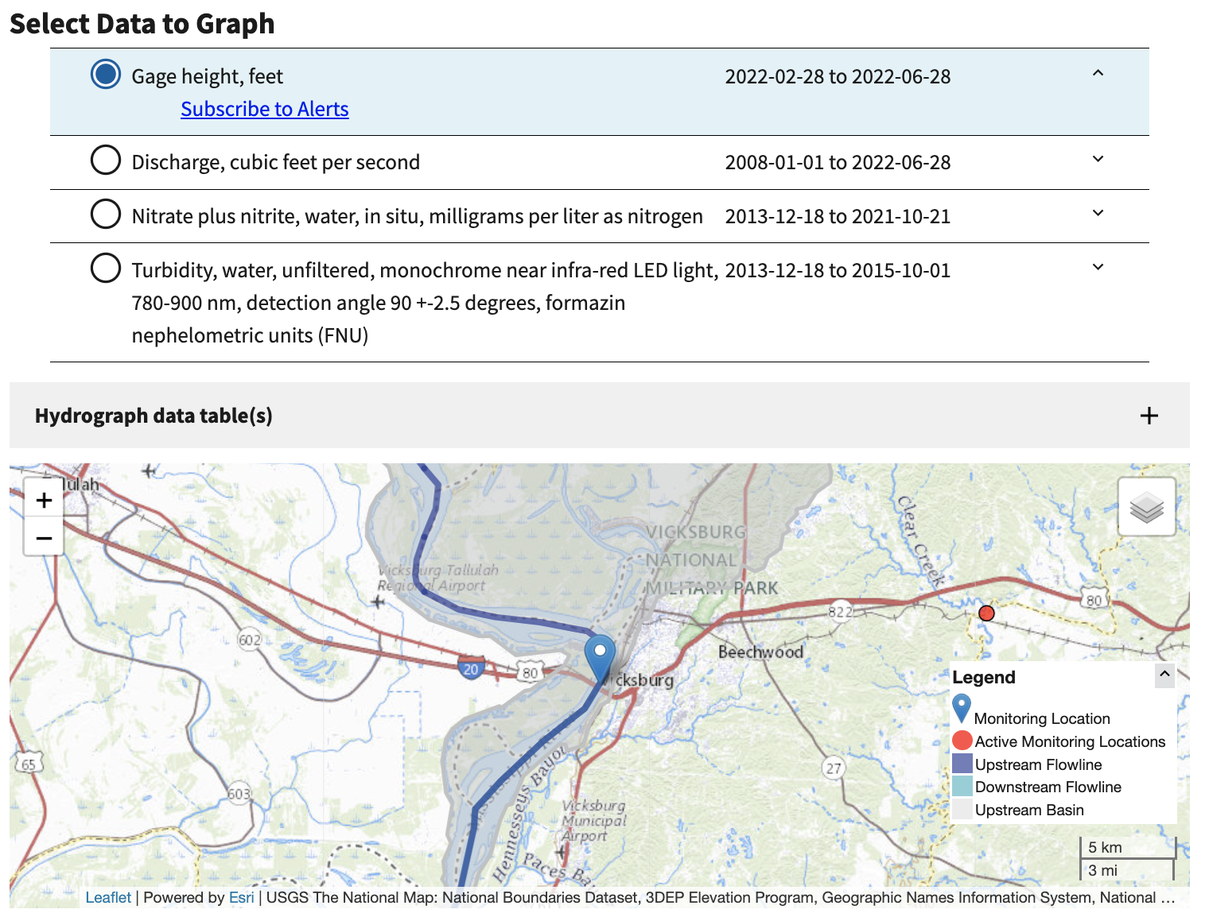
Methods:
Hydrofunctions
Courtesy of USGS
Notes:
This is what USGS stream gage might look like
Note that we’re only measuring stream gage data at one point in the Mississippi
Somewhat iterable for different gage locations

Slide 6
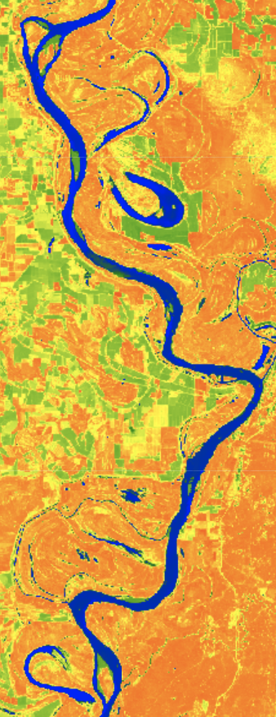
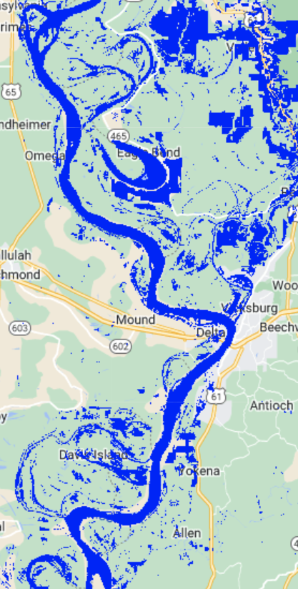
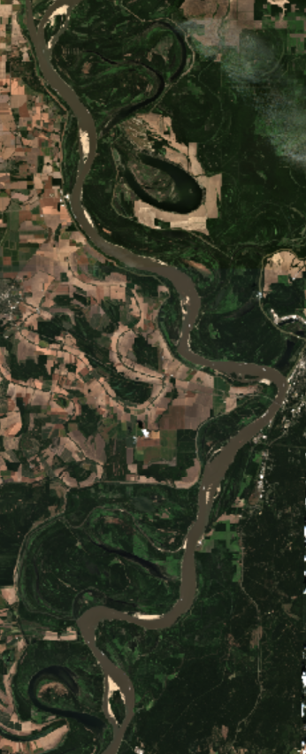
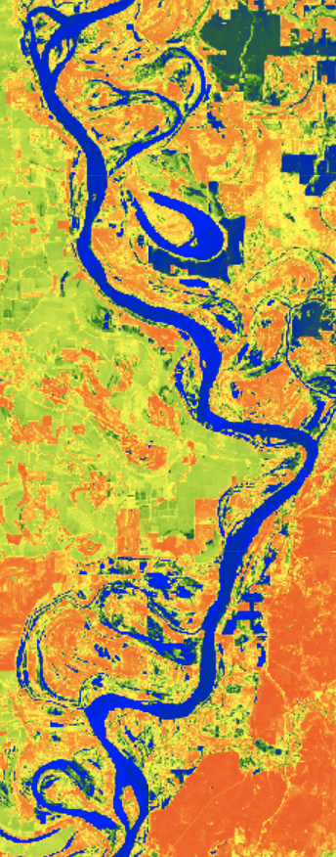
Example:
Vicksburg, Mississippi
Notes:
Show basic aerial imagery from Sentinel - 2
Show NDWI images
Show before, during and after water extractions
Natural swell

Slide 7
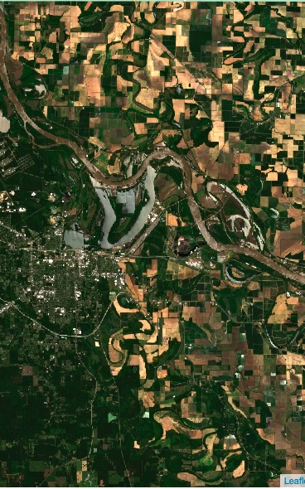
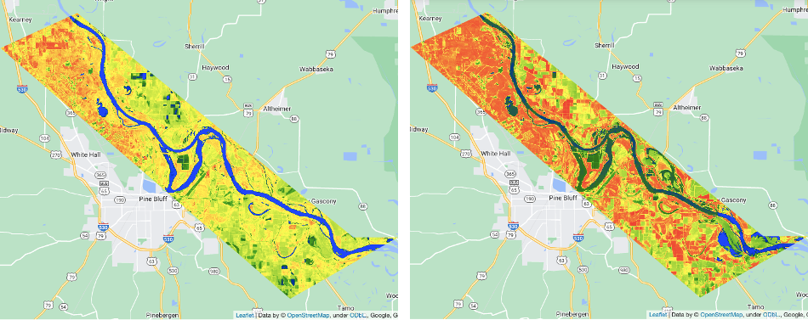
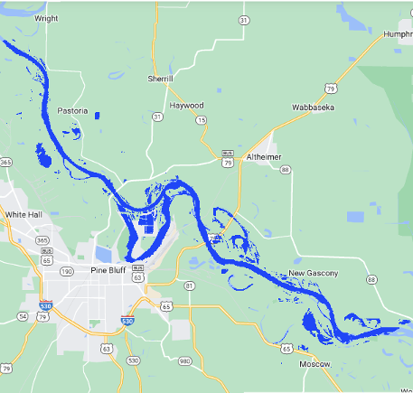
Example:
Pine Bluff, Arkansas
Notes:
Show basic aerial imagery from Sentinel - 2
Show NDWI images
Show before, during and after water extractions

Slide 8
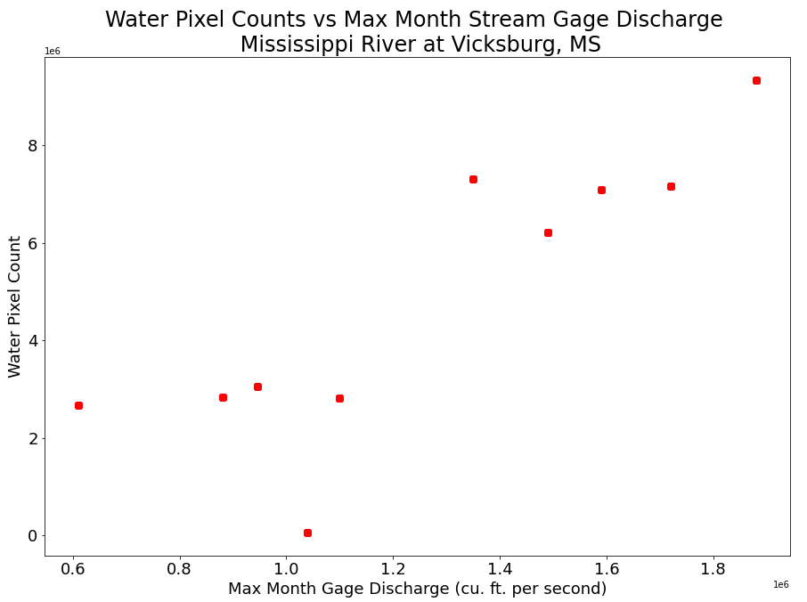
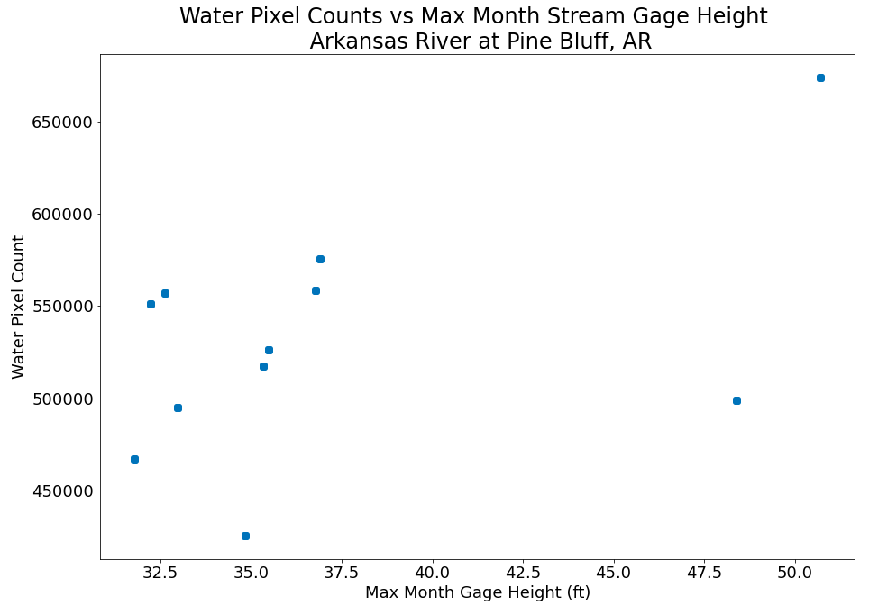
Results: Relationship Between Flooding Extent and Stream Gage Data
Notes:
Describe what these plots are showing:
They show water pixel count (representing flooding extent) on y axis, versus river gage data on x-axis. For mississippi site on left, river gage data is discharge in cfs. On right, pine bluff site uses gage height data, representing the level of water in river.
What we expected to see was a fairly flat line at lower discharges or gage heights, when the river is at typical day to day levels, and then above a certain trigger point, or a certain discharge or gage level point at which flooding begins, we would expect to see a rapid increase in pixel count as water begins to flood the banks.
We see this pattern more in the mississippi site.

Slide 9
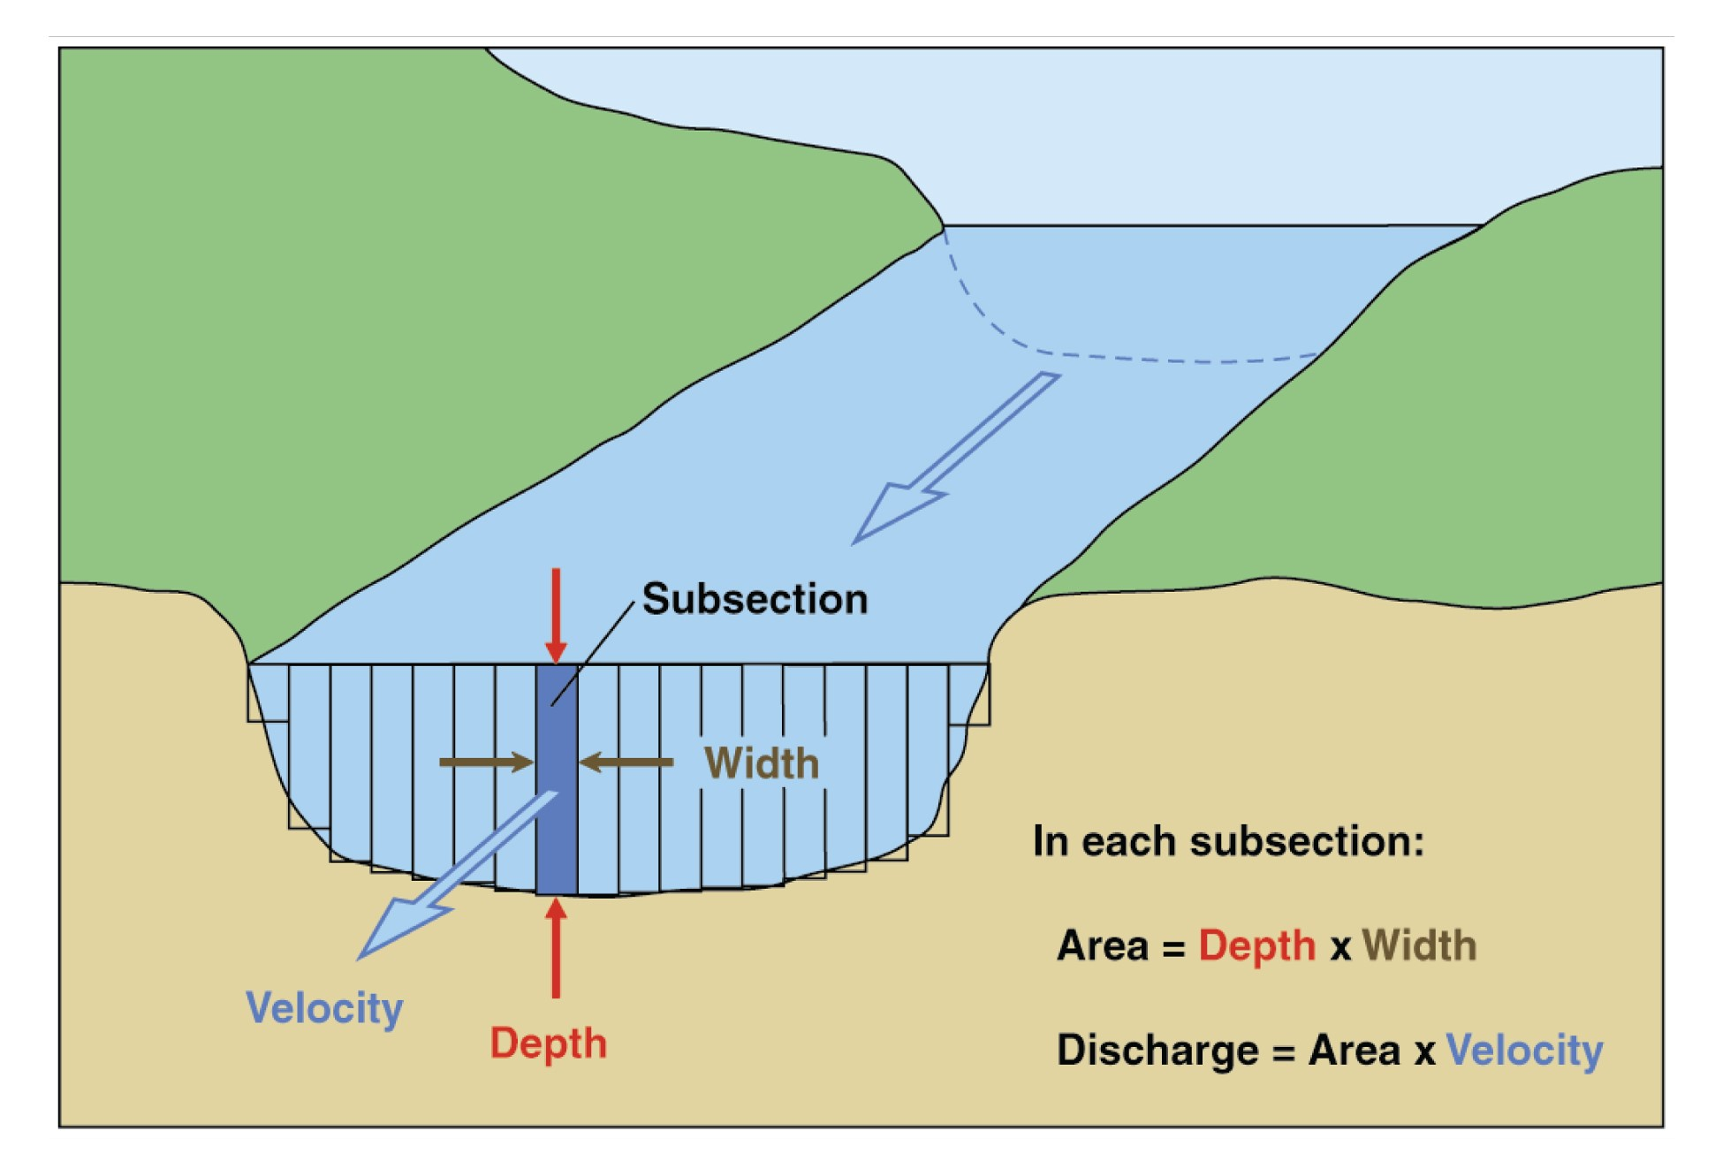
Conclusions
Proof of concept established
Visual correlation between flood extent and discharge vs gage height
Specific boundary conditions for each location
Active remote sensing data for cloud coverage
Courtesy of USGS
Notes:
Proof of concept established
This overall methodology does appear to show some relationship between gage data and flood extent, but we would need more analyses to truly define those relationships mathematically
Stream discharge may be a more reliable measurement for flood detection than gage height
Data availability
This makes sense because discharge is more representative of volume than gage height, and flood extent is naturally closer related to volume.
But this conclusion requires additional analyses (at various locations/times) in order to say with absolute certainty.
Each location will likely require specific boundary conditions to ensure accurate water pixel count values
Analysis may benefit from using active remote sensing data (ex. Sentinel-1) to circumvent cloud cover
Using remote sensing data with radar capabilities would help ensure that we can get accurate water pixel counts, particularly during major flood events, in which we can expect to see cloudy skies.

Slide 10
Next Steps and Implications
Next Steps:
Refine and document uncertainty in the process:
Composite images
Possible solution: Instead of using GEE, generate images specific to each gage data point
Cloud cover during floods
Possible solution: Utilize activer remote sensing data (such as Sentinel-1), which can see through cloud cover
Each site needs analysis, i.e. it’s not repeatable currently
Possible solution: Only extract rivers with stream discharge data, not gage height; automate boundary conditions - have computer recognize river lines
Extracting water pixels outside of the riverbed topology
Possible solution: Create boundaries around the riverbed
Implications:
Cross-section to better understand the way river channels change
Machine learning - can we make this predictive?
Notes:
uncertainty

Slide 11
Thank you for listening!
Any questions?
Avra.Saslow@colorado.edu
Kristen.Tortorelli@colorado.edu

